Slide 1
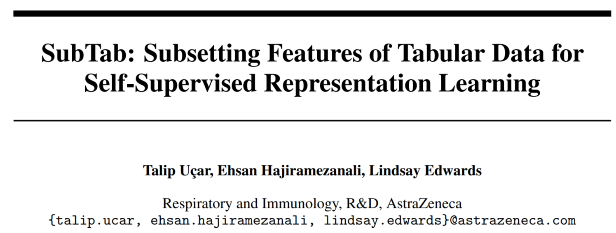
NIPS 2021

Slide 2
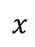
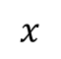
Motivation
Self-supervised learning is under-studied in tabular domain
Common approach: reconstructing data from its corrupted version
$$x$$
encoder
decoder
$$x$$
Auto-encoder
This paper: reconstructing data from the subset of data’s features

Slide 3
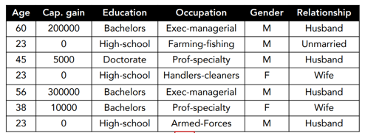
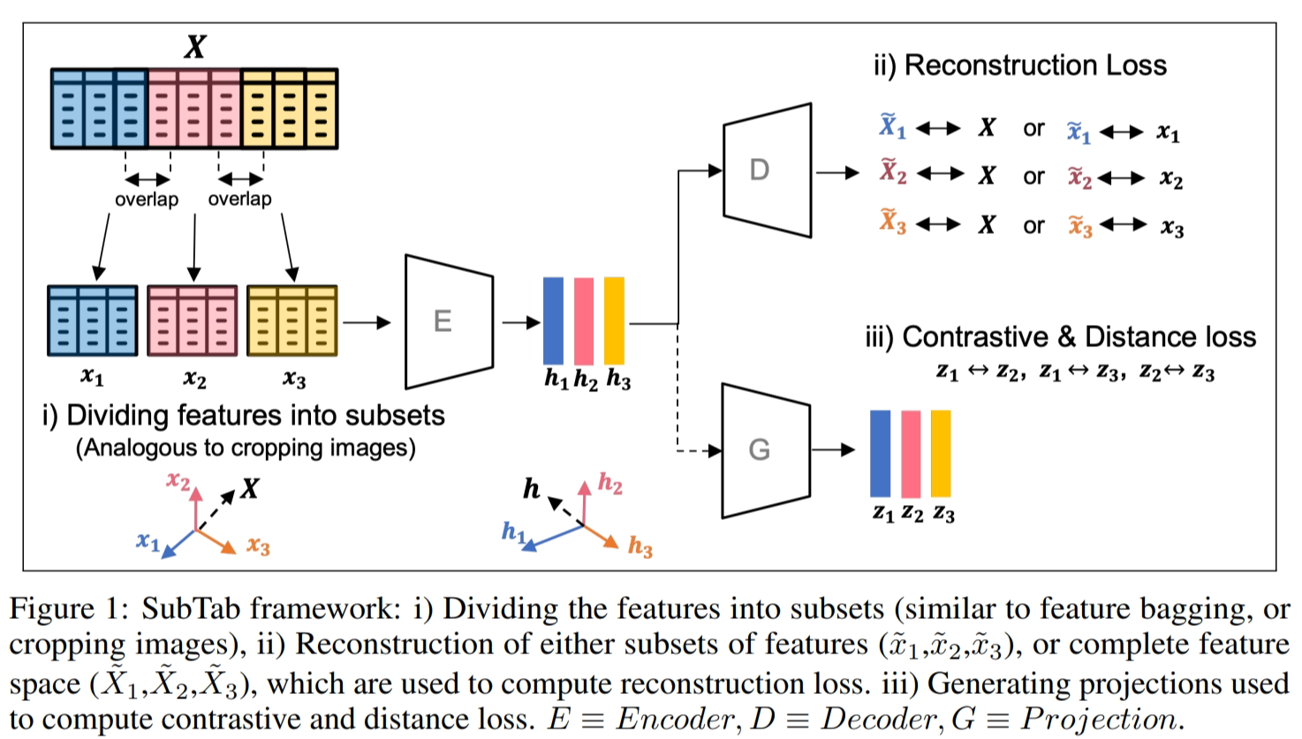
Framework
Self-supervised learning
training a logistic regression model on the latent representations of the training set
testing it on the latent representation of the test set

Slide 4
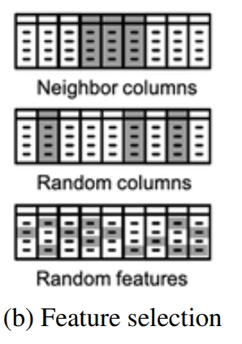
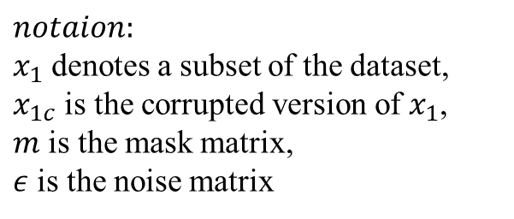
Framework
Add noise
$$notaion:$$
$x_{1}$ denotes a subset of the dataset,
$x_{1c}$ is the corrupted version of $x_{1}$,
$m$ is the mask matrix,
$ε$ is the noise matrix
Select feature to add Noise
Select a block of neighboring columns
Select columns randomly
Random features
Noise type
Adding Gaussian noise
Overwritting the value of a selected entry with another value randomly sampled from the same column, referred to as swap-noise
Zeroing-out randomly selected entries, referred to as zero-out noise

Slide 5
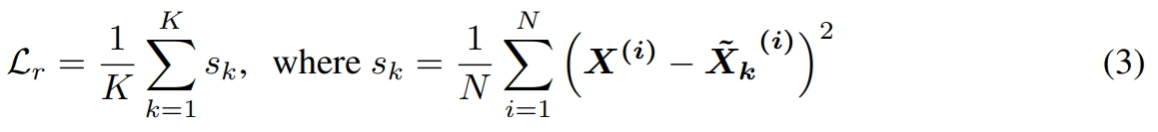
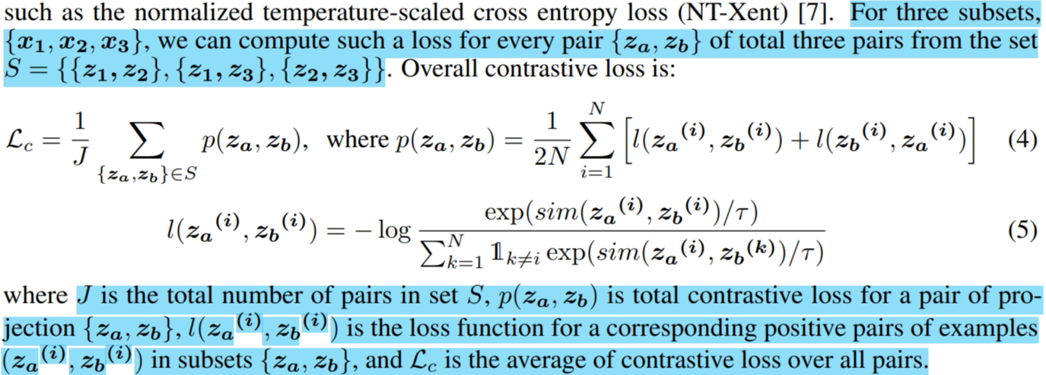
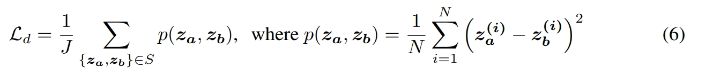
Training
Total loss
Reconstruction loss
Total loss consists of construction loss, contrastive loss, and distance loss.
Contrastive loss and distance loss are optional
Contrastive loss
Distance loss

Slide 6
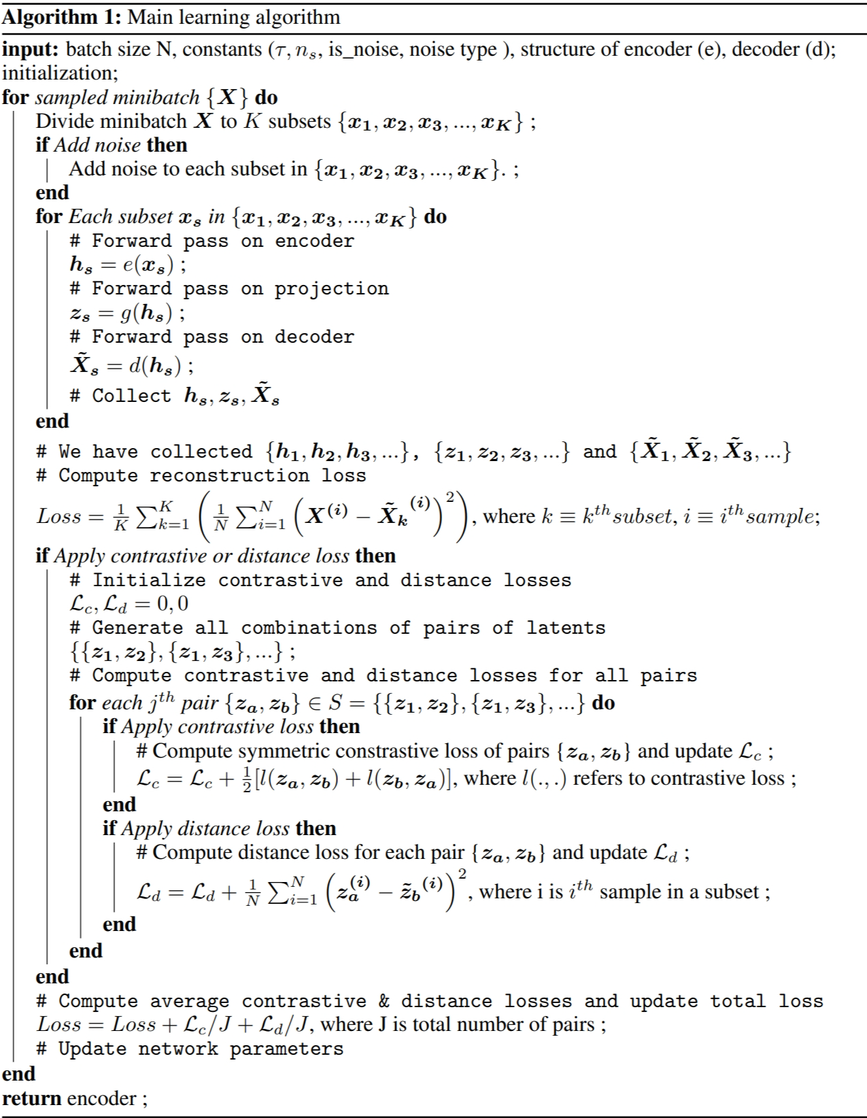
Training
Algorithm

Slide 7
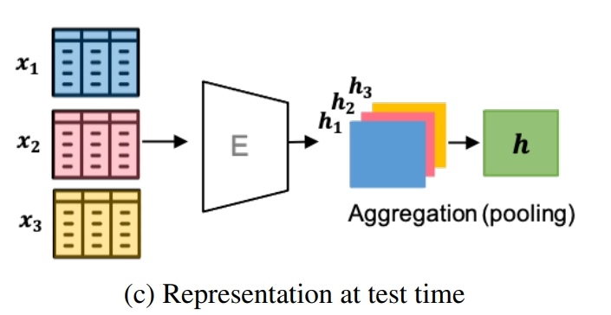
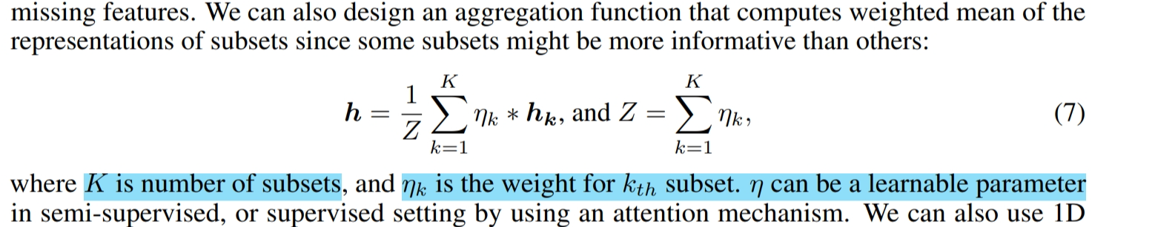
Test time
Test time framework
Input data: input subsets of data, for each subset, get a representation h
Aggregation
Mean, sum, max, min
Weighted mean
Predict
K is the count of subsets, $η_{k}$ is the weight for $k_{th}$ subset, $η$ can be a learnable parameter

Slide 8
Experiments
Dataset
MNIST
The Cancer Genome Atlas
Obesity
UCI Adult Income
UCI BlogFeedBack

Slide 9
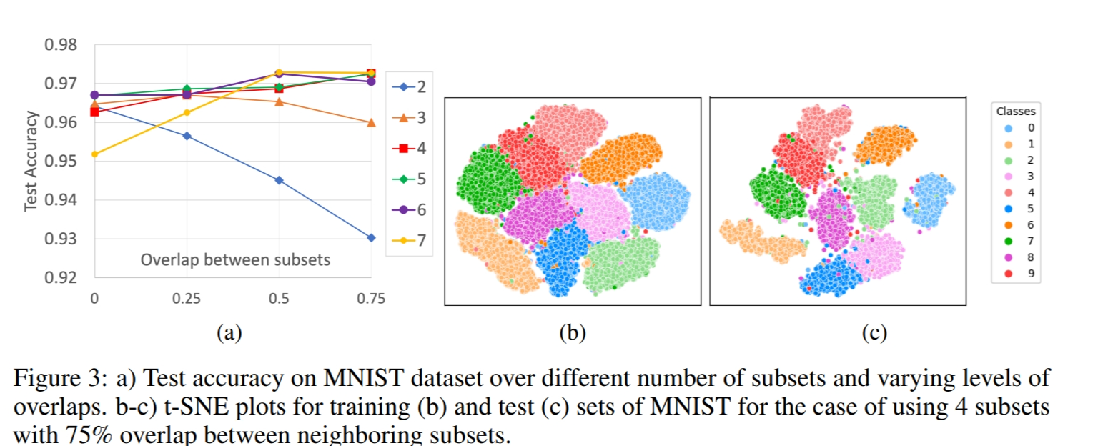
Experiments
First experiment: varying the split number of subsets
For each training, different numbers of subsets with different levels of overlap between neighboring subsets were used

Slide 10
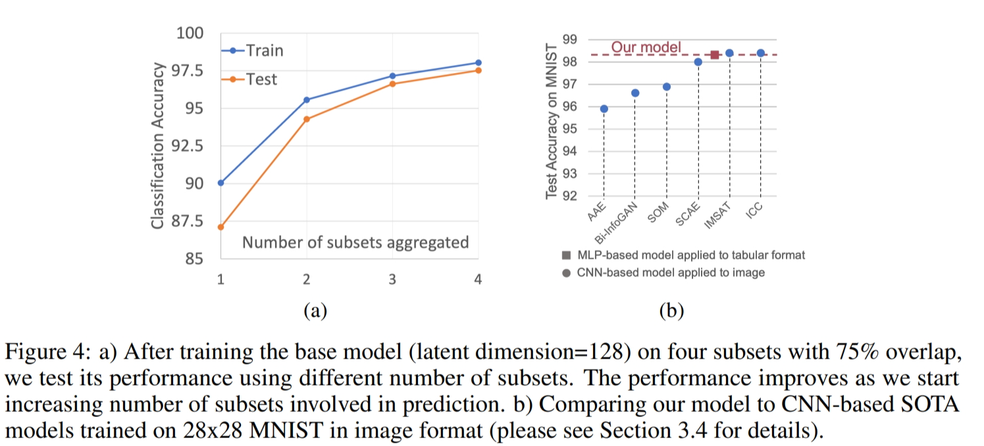
Experiments
First experiment: varying the split number of subsets
Varying number of aggregated latent representations, under the optimal case of K=4 with 75% overlap

Slide 11
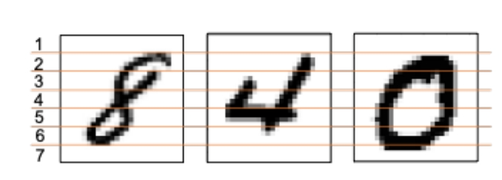
Experiments
Second experiment: evaluated Subtab under the condition of missing features during training
Subset splitting
Sliced the unshuffled features of MNIST to seven subsets with no overlap

Slide 12
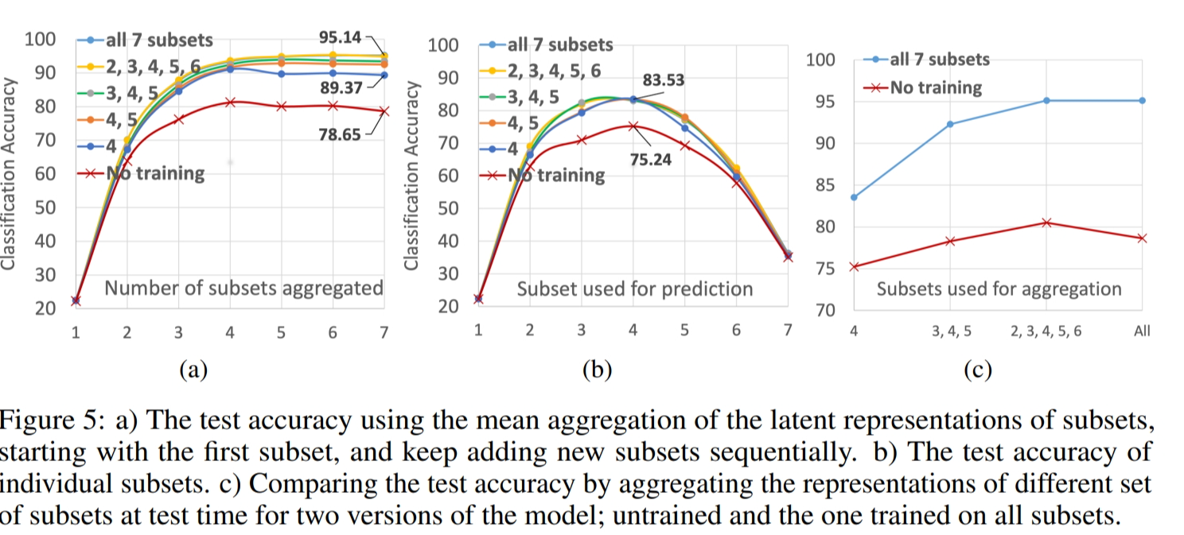
Experiments
Second experiment: evaluated Subtab under the condition of missing features during training
Five models were trained on five different sets of subsets: {4},{4,5},{3,4,5},{2,3,4,5,6},{1,2,3,4,5,6,7}
In Figure 5a, the number of subsets aggregated denotes training and evaluation a logistic regression model by using the joint embedding of the following seven sets: {1},{1,2},{1,2,3},…,{1,2,3,4,5,6,7}

Slide 13
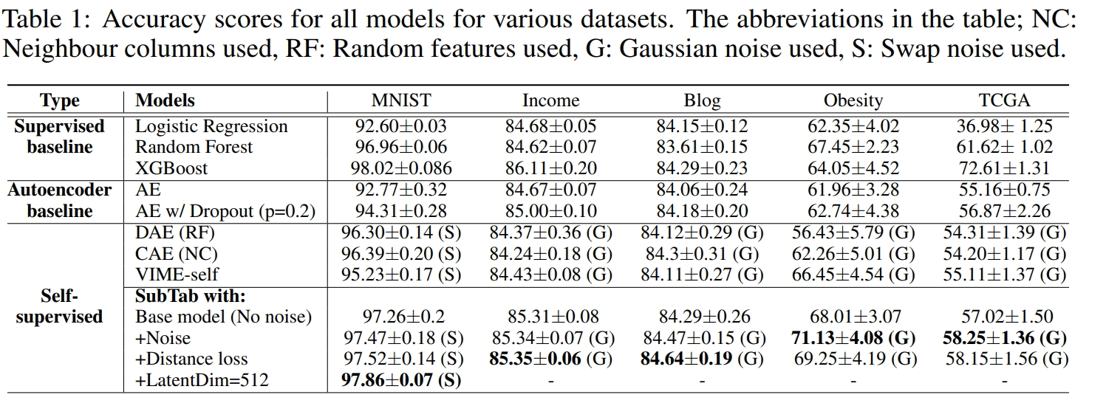
Experiments
Third experiment

Slide 14
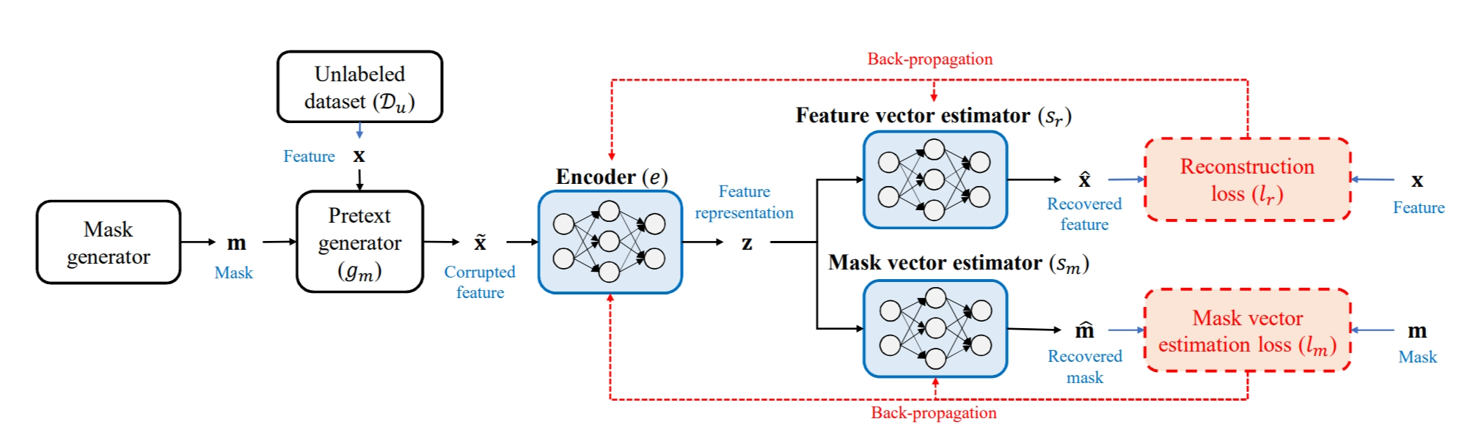
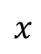
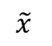
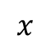
Denoising autoencoder
Context autoencoder
$$x$$
$$\tilde{x}$$
encoder
decoder
$$x$$
VIME

Slide 15
Thanks

